Slide 1
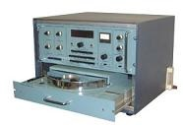
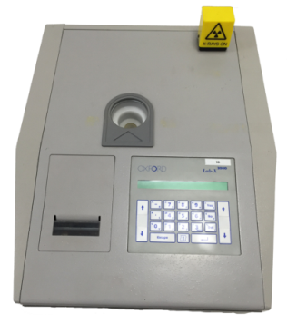
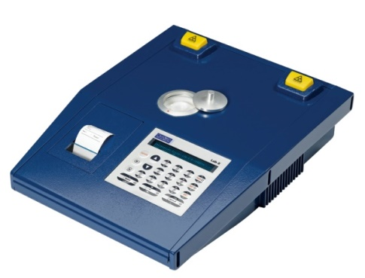
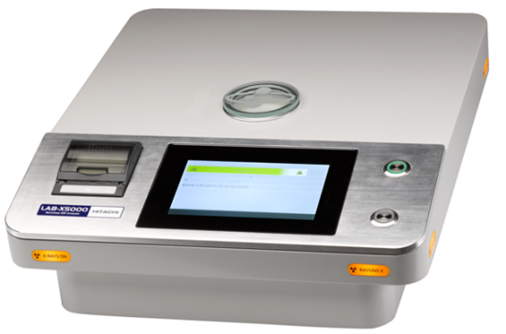
LAB-X – Tried and trusted for 45 years
Lab-X2000
Integrated electronics console
Lab-X320
Two heads, greater range
Lab-X1000
New design, 3-position turntable
Lab-X3500
Component update and facelift
Lab-X3000
Tube, patented Focus 5 head
Lab-X3000S
Low-sulfur variant
Lab-X3500SCl
Air path low-sulfur
Lab-X100
Isotope for Al-Fe
LAB-X5000
New design, touch screen
1972
1976
1982
1987
1993
1998
2000
2006
2017

Slide 2

LAB-X5000 is ready to work
The LAB-X5000 is a benchtop energy dispersive X-ray fluorescence (EDXRF) instrument for elemental analysis in quality control, production control, test laboratories and mobile operations.
It is easy to use and streamlined for high sample throughput – any operator can get high quality results.

Slide 3
Versatile analytical capabilities
Measure elements Mg – U in liquids, powders, solids, papers, films, etc.
High resolution SDD detector enables shorter measurement times and simultaneous analysis of multiple elements
Analyze from low ppm to wt% range
Results are displayed and updated throughout analysis for quick decision making
Analysis is non-destructive
Rugged design for placement in production environments
Does not use helium or vacuum, reducing operating costs

Slide 4
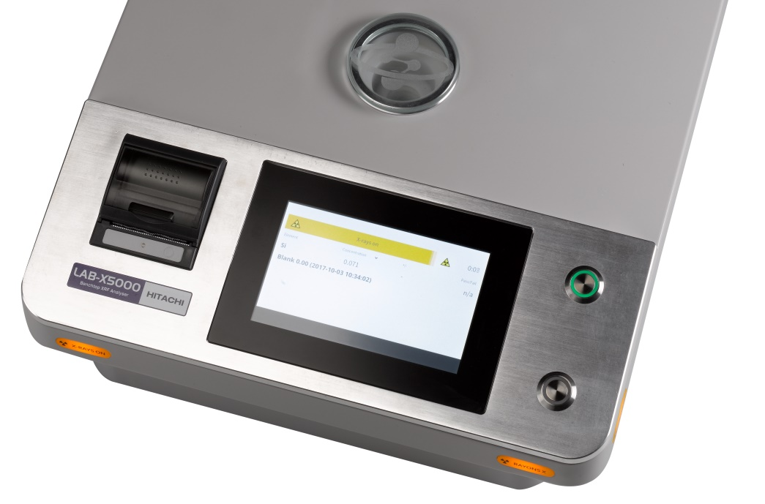
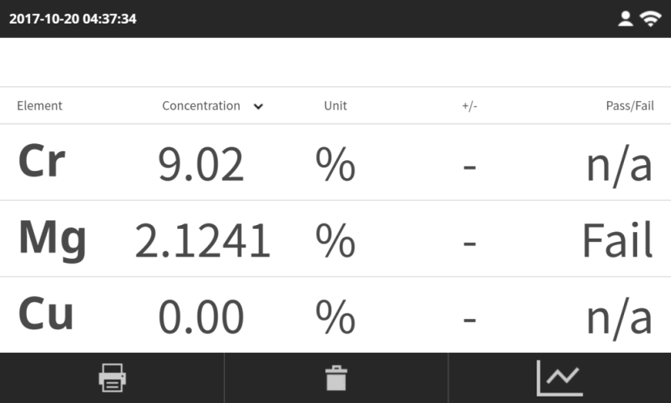
Easy to use
One-touch measurement start
Load a sample then push the start button
Shortest start sequence in the market
Point-and-shoot driven software displays results clearly
Industrial grade 7” touch screen
Bright display with high contract for easy viewing
Resistant to damage from physical abuse, chemicals and solvents

Slide 5
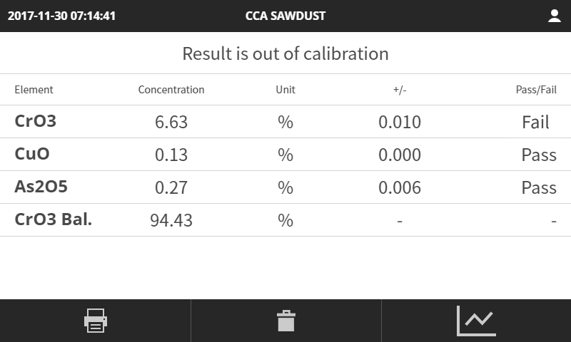
Clear, comprehensive results display
SmartCheck provides additional information to help operators make decisions
Pass/Fail messages can be set for all or selected elements
Parameter calculated from calibration results
Eg. CrO3 Bal. = 100 * CrO3 / (CrO3 + CuO + As2O5)
Toggle to see spectrum

Slide 6
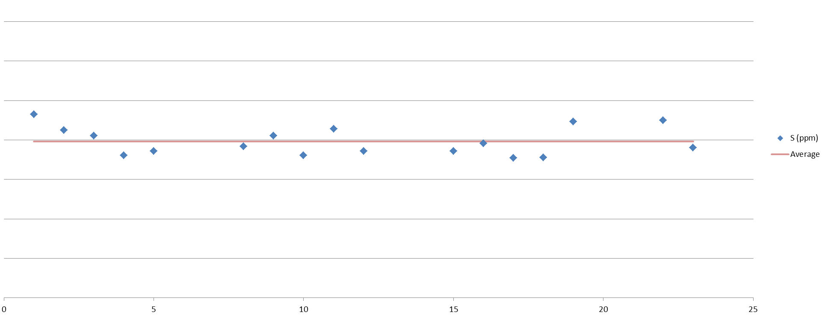
Stable results, day after day
Analytical stability is critical for quality control and process control purposes. The LAB-X5000 has several features to ensure stable results:
Periodic peak position verification is performed automatically and without any input from the user
Atmospheric compensation monitors and corrects for changes to temperature and pressure as they could affect X-ray analysis
Days since calibration

Slide 7
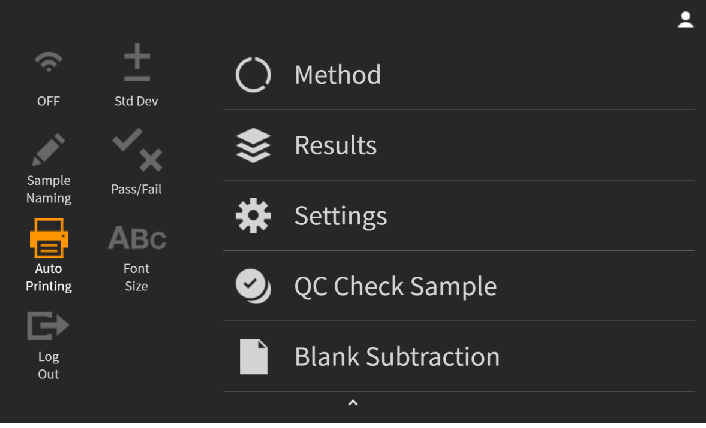
Powerful features in pull-down menu
Quick toggle options for routine analysis
Concealed menu leaves more space for results during routine analysis
Offers easy access to features for:
  Creating or editing calibrations
  Investigating unknown materials
  Exporting results

Slide 8
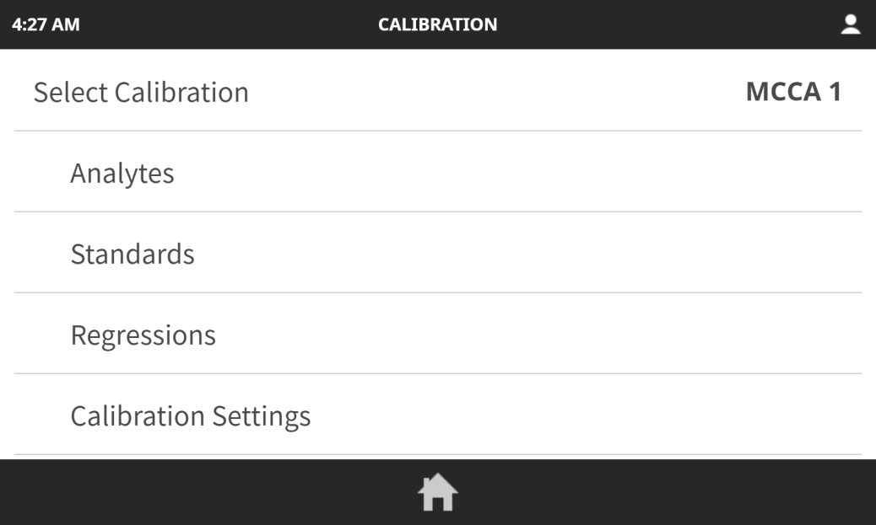
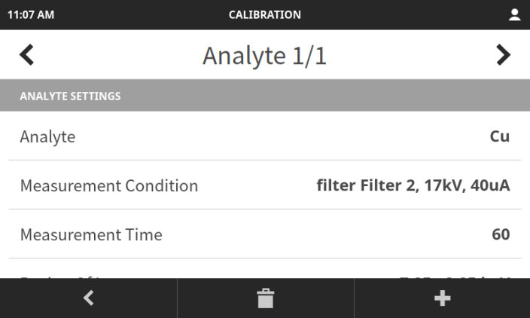
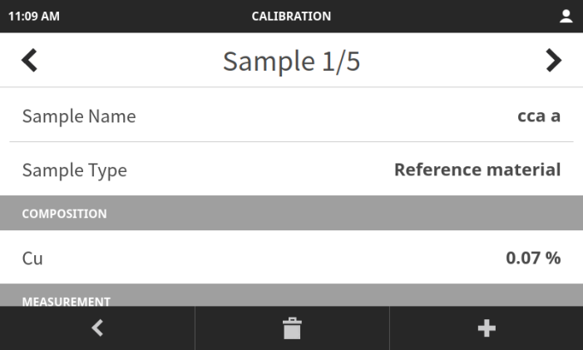
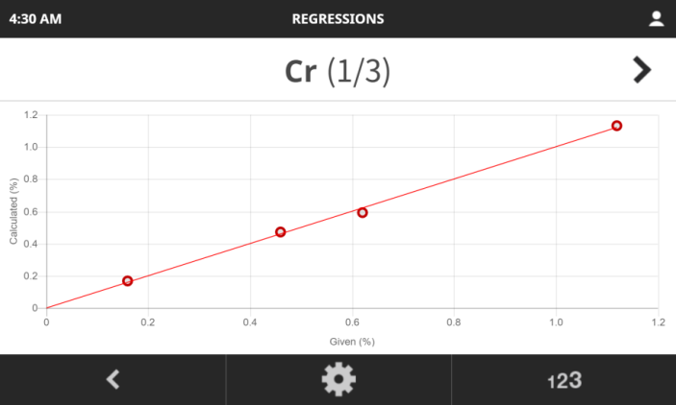
Easy calibration setup and maintenance
Follow the guide to create a calibration:
1 – define the elements to be analyzed using pre-defined, optimized settings
2 – add and measure the calibration standards
3 – set the regression
Need help? Our applications experts are ready to support you.
1
2
3
1
2
3

Slide 9
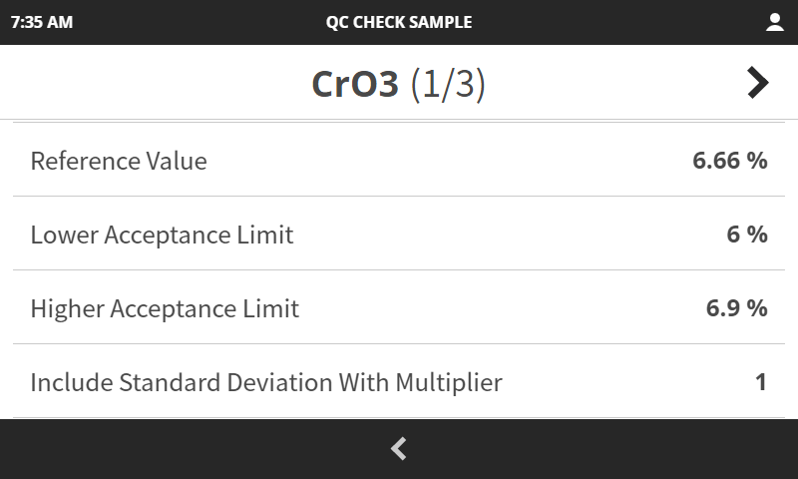
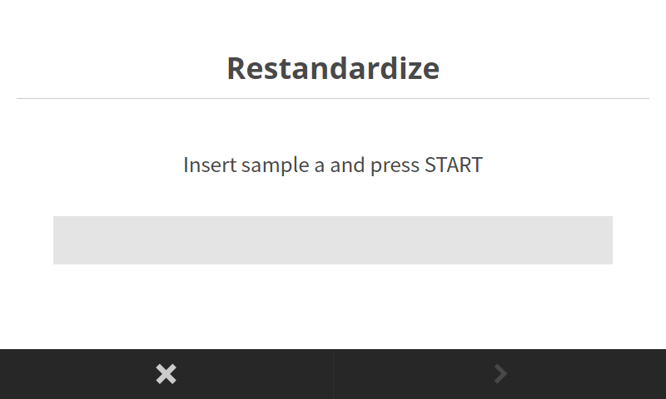
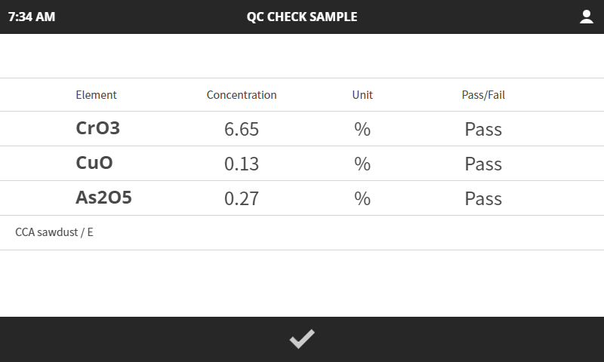
Easy calibration setup and maintenance
Validate calibration performance by measuring a defined quality control check sample
Restandardize with the provided setting up samples (SUS) instead of performing a full recalibration
Faster and easier than recalibrating
Reduces costs from using or damaging valuable reference materials

Slide 10
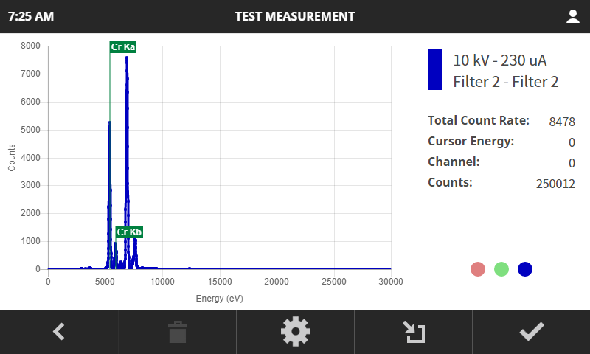
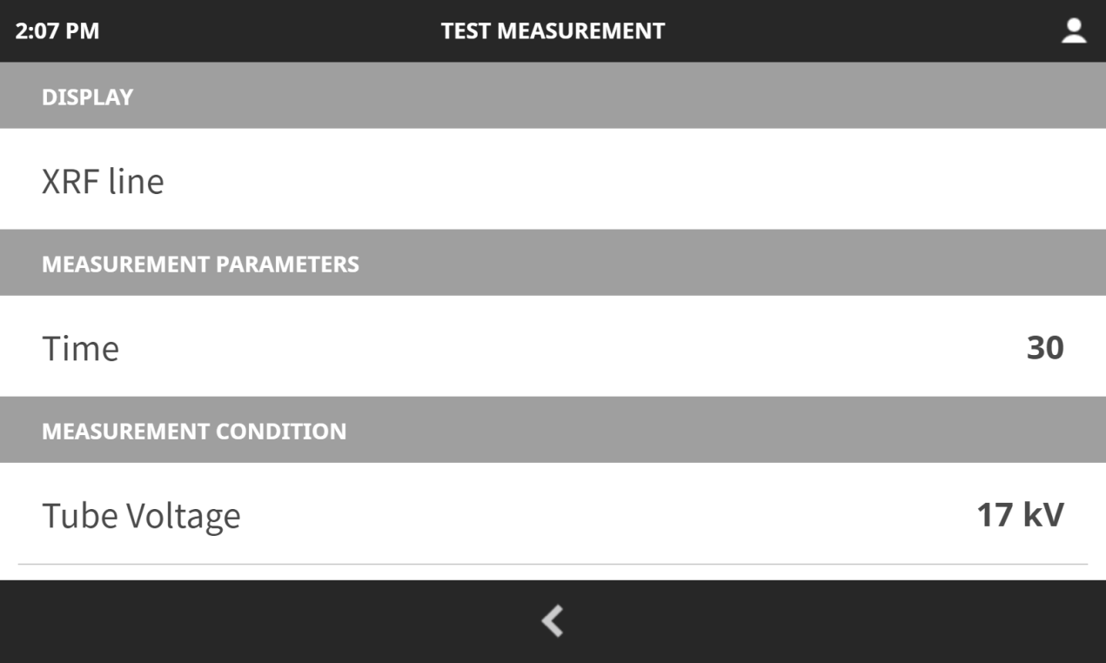
Qualitative investigation tool
Study an unknown sample without a calibration
Identify peaks with the XRF line display function
Compare spectra to known materials

Slide 11
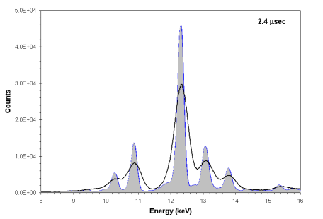
Fast and flexible analysis
The LAB-X5000 high resolution SDD provides:
Faster analysis
Lower detection limits
Greater flexibility for future analytical requirements
SDD
PIN
 | Proportional Counter | PIN Diode | Silicon Drift Detector (SDD)
Background
Resolution
Countrate
Detection limit
Speed
Better
Better
Better
Better
Better

Slide 12
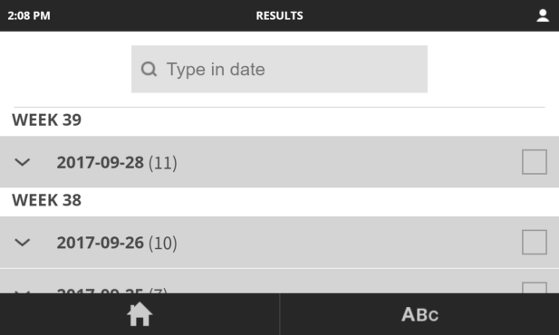
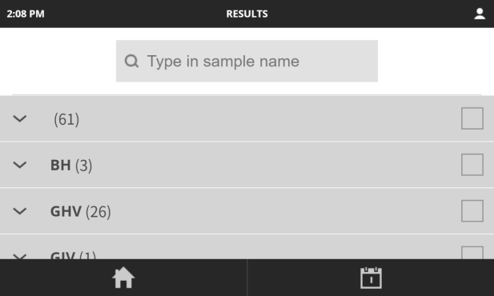
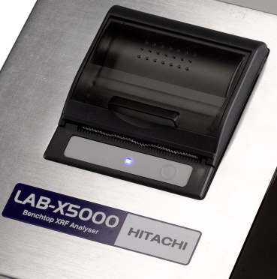

Advanced data handling
Store up to 100,000 results with spectra
Three convenient reporting options
Export results via USB
Search for specific results by name or date
Use the integrated printer for automatic or on-demand reporting
Upload results to LiveConnect, our cloud-based service for data backup and remote access to easily monitor instruments at multiple facilities

Slide 13
LAB-X5000
NEW touch screen
NEW user interface
NEW one-touch measurement
NEW data handling
NEW detector
NEW smaller footprint
NEW audible alert
Mg – U analysis
No helium or vacuum
But it’s still a LAB-X
Easy to use
Reliable
Stable
Fast
Compact
Protects against spills

